Slide 1


August 2019
Federated Health Information Model (FHIM) Profile Builder
FHIM A Team, Apprio, Inc.
Steve Wagner, Galen Mulrooney, Jay Lyle, Sean Muir, Ioana Singureanu, Rob McClure, Steve Hufnagel
The Open Group
Jason Lee
Classification: Unrestricted

Slide 2
Introduction
Jason Lee PhD, Director, OpenGroup Healthcare Vertical
The Open Group is a global consortium that enables the achievement of business objectives through technology standards. Our diverse membership of more than 600 organizations includes customers, systems and solutions suppliers, tools vendors, integrators, academics, and consultants across multiple industries.
The mission of The Open Group is to drive the creation of Boundaryless Information Flow™ achieved by:
Working with customers to capture, understand, and address current and emerging requirements, establish policies, and share best practices
Working with suppliers, consortia, and standards bodies to develop consensus
and facilitate interoperability, to evolve and integrate specifications and
open source technologies
Offering a comprehensive set of services to enhance the operational
efficiency of consortia
Developing and operating the industry’s premier certification service and encouraging procurement of certified products
Classification: Unrestricted

Slide 3
Boundaryless Information Flow achieved through global interoperability in a secure, reliable, and timely manner is the Open Group’s motto.
The Open Group: in its healthcare vertical’s Making Standards Work® effort is developing an FHIM Profile Builder to generate HL7 FHIR and CDA information exchanges. (FHIM is the Federated Health Information Model).
The Open Group works with customers and suppliers of technology products and services, and with consortia and other standards organizations to capture, clarify, and integrate current and emerging requirements, establish standards and policies, and share best practices. The Open Group standards ensure openness, interoperability, and consensus.
Classification: Unrestricted

Slide 4
This presentation summarizes the FHIM Profile builder and its components. The FHIM Profile Builder is important because, HL7 FHIR and Healthcare IT related government policies are rapidly evolving and maturing. Current, FHIR tools are fragmented and require deep expertise of the underlying standard and the details related to information exchange requirements. They are not seamless to use. Also, there is significant implementation variability among seemingly similar FHIR profiles. FHIR implementers often lack standards experience and produce specifications that are ambiguous resulting in poor cross platform interoperability.
Meeting the Open Group Boundaryless Information Flow vision is one of the highest FHIM Profile Builder value propositions, which lies in its ability to efficiently and effectively assist developers and clinical stakeholders, with FHIM-harmonized FHIR resource patterns, to build workflow-specific (without special effort) interoperability components (e.g., FHIR profiles, CDA templates, etc.). This is a big deal!
Classification: Unrestricted

Slide 5
Why do we need the FHIM and the
FHIM Profile Builder?
One of the highest value propositions for the FHIM lies in its ability to assist developers and clinical stakeholders by building interoperability components, using HL7 FHIR, CDA, V2, etc. which can be used by other developers and stakeholders (without special effort) in their APIs, component’s and services.
FHIR is immensely popular, in large part because it is easy to use and solves the data transfer problem in interoperability.
However, FHIR, by design, does not ensure that health data that is meaningfully shared in one implementation instance can be meaningfully shared in any other implementations.
As a result, the widespread adoption of FHIR is producing thousands of profiles that cannot be reused without special effort.
A FHIM profile builder would assist the FHIR, CDA, V2 communities by producing consistent-reusable standard-based profiles, and thereby help significantly advance interoperability.
Classification: Unrestricted

Slide 6
FHIM Profile Builder Benefits
The FPB Model Driven Architecture approach addresses both modeling and implementation issues and accelerates creation of FHIR profiles and implementation guides by:
Providing tools that are easier to use and that
Generate profiles and guides more efficiently
With improved accuracy and improved reuse
Making users more effective and productive
Reducing implementation variability
Maintaining traceability to legislation, policies and requirements.
Classification: Unrestricted

Slide 7
FPB Profile Editor: Future Enhancements
Allow users to organize their profiles into Implementation Guides
Use FHIR Implementation Guide resource to store the information in FHIM or an associated FHIR server
Create FHIR profiles to describe the constraints needed to represent FHIM logical content as FHIR Structure Definition resources using the FHIR API specification (Search, Create, Update operations)
Examples provided in Github FPB Profile Editor project: https://github.com/FHIMS/FHIMProfileBuilderWeb
Create a FHIM template based on a another existing FHIM template (e.g., create an organization-specific template from a US-Core specification template)
Change the base structure from a “class” to a “template”
Connect the Profile Editor to a FHIR Terminology Server to access existing value sets
Support changes to value set members and adding terminology constraints to coded information from the FHIM
Add more options to the Profile Generator in addition to FHIR Profiles Integration with a Terminology Server
Create a set of FHIM templates corresponding to US Core FHIR profiles
These pre-loaded templates can then be used to efficiently create extensions to US Core FHIR Profiles that are conformant to the existing US Core FHIR profiles
A possible Profile Editor enhancement is GoldenLayout at https://golden-layout.com/
Classification: Unrestricted

Slide 8
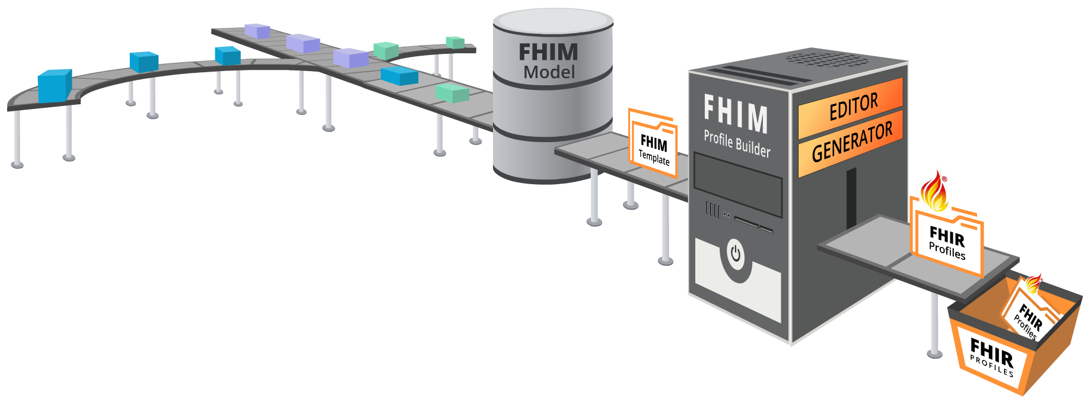
FHIM Profile Builder Process
2. Information
Modeling
3. Terminology
Modeling
1. Use Cases
4. FHIM Profile Builder
5. FHIR
Profiles

Slide 9




FPB 2019 Overview
FPB Editor GET
FHIM Profile Editor
GET: FHIM Element Name
Return: StructureDefinition
Use Case Constraints
FPB Editor POST: FHIM Template StructureDefinition
POST: FHIM Template StructureDefinition
Return: FHIM Template ID
FHIR API
(StructureDefinition)
FHIR Operation
(GENERATE)
FPB Editor StructureDefinition/generate
GENERATE
RETURN: FHIR Profile ID/Version
MDHT
for
FHIR STU4
STU4
Profiles
FPB Editor GET: FHIR Profile ID & Version
GET: FHIR Profile ID & Version
Return: FHIR Profile
FHIR UML
Repository

Slide 10


FHIM Profile Builder™
FPB Editor
Federated Health Information Model
Classification: Unrestricted

Slide 11
FPB: Profile editor overview
A component of the FHIM Profile Builder
A web-based tool intended for business analysts and integrators (users)
It allows users to identity what data elements are necessary to fulfill one or more interoperability use cases and define the contents of a standard-based transaction or resource
The user may create a FHIM Template by retrieving a FHIM class and identifying which data elements are mandatory, supported, or not supported according to their implementation requirements/use cases
The user can save a template for further editing or
The user can invoke the FHIM Profile Generator to create a FHIR profile based on the data elements in the template

Slide 12
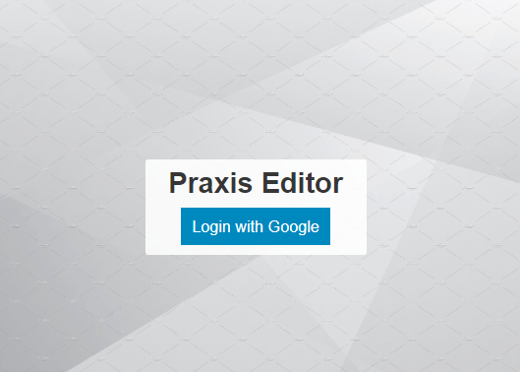
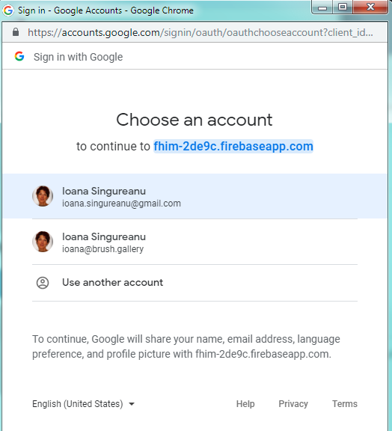
Login screen
Google OAuth2 developer SDK (firebase)
Future enhancement:
This capability should reuse Open Group authorization server intended to give members access to tools and resources
Profile

Slide 13
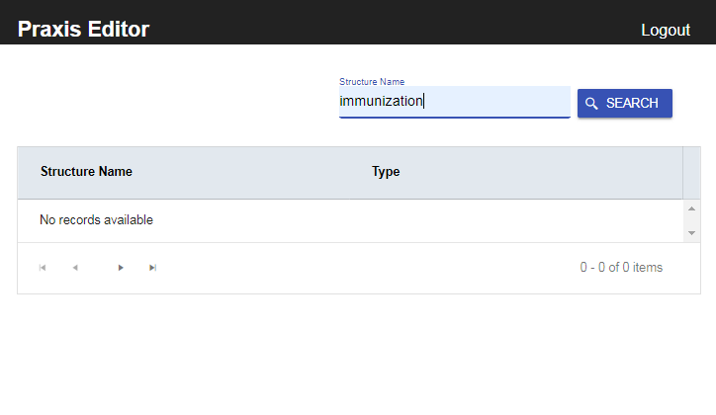
Search Screen
Enter a “structure name” to search classes and templates defined in FHIM
The search string will use the structure name:
Class name
A composite name for Template
Base class name
Organization
Template title
Template version
Profile Editor

Slide 14
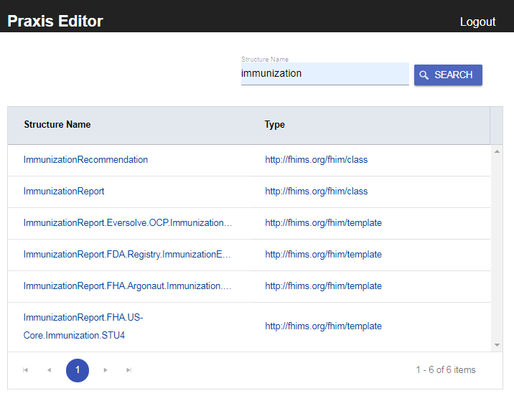
Profile Editor
The structured returned from the server are displayed by “structure name” and “type”
They can be sorted by those columns
By default they are all sorted by class name
This way the users can find everything related to the specific class with one query
The structure name consists of The class name if the type is “class” or
A composite name if the type of structure is “template”
Base class name (E.g. ImmunizationReport)
Organization (e.g FHA)
Implementation Guide (e.g. US-Core, Argonaut, CRN)
Template title (e.g. Immunization)
Template version (e.g. STU4, 1.1, etc.)
Profile Editor
classes
FHIM class name
templates
10 entries per page – set by server

Slide 15
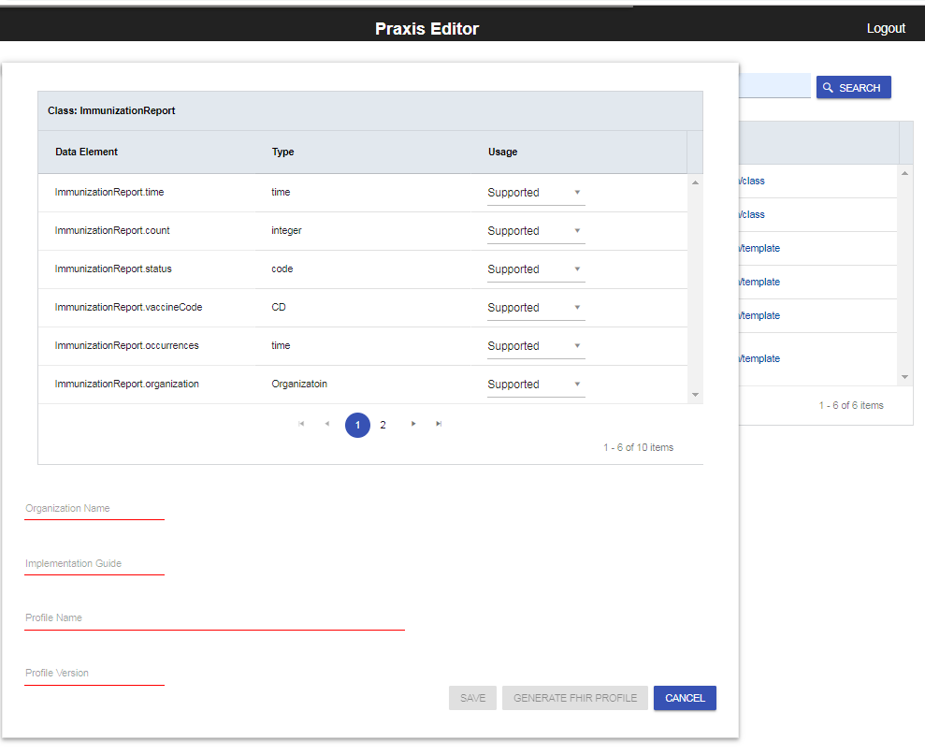

Create a template from a FHIM class
If the user selects a class from the list, the user may edit “usage” and metadata:
Organization responsible for the project, implementation guide, and profile
Implementation Guide that contains the template
Template title
Template version
Profile Editor
FHIM Class that will be used for the template

Slide 16
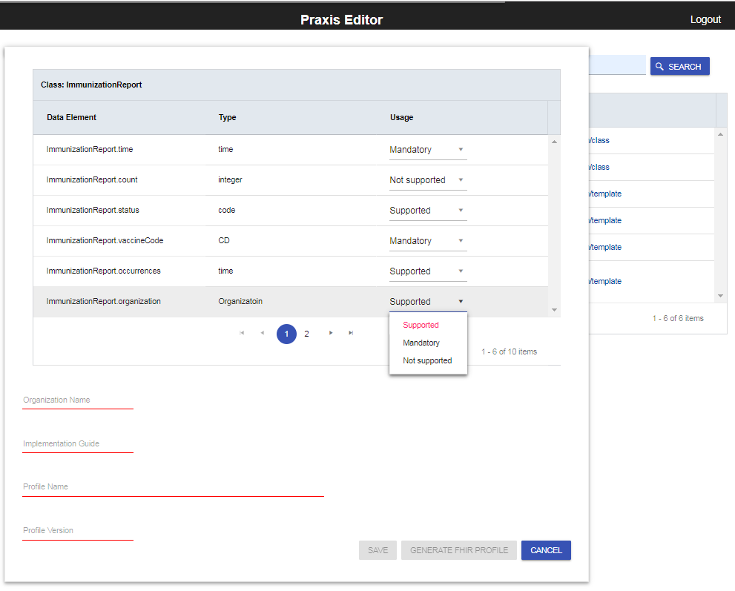
Create a template from a FHIM class
Profile Editor
Mandatory
Not supported by the project
If the user identifies which data element/attributes of the FHIM class are either mandatory, supported, or not required or prohibited (not supported).
The Save button is disabled until the metadata is filled out → 
Select the usage based on project requirements

Slide 17
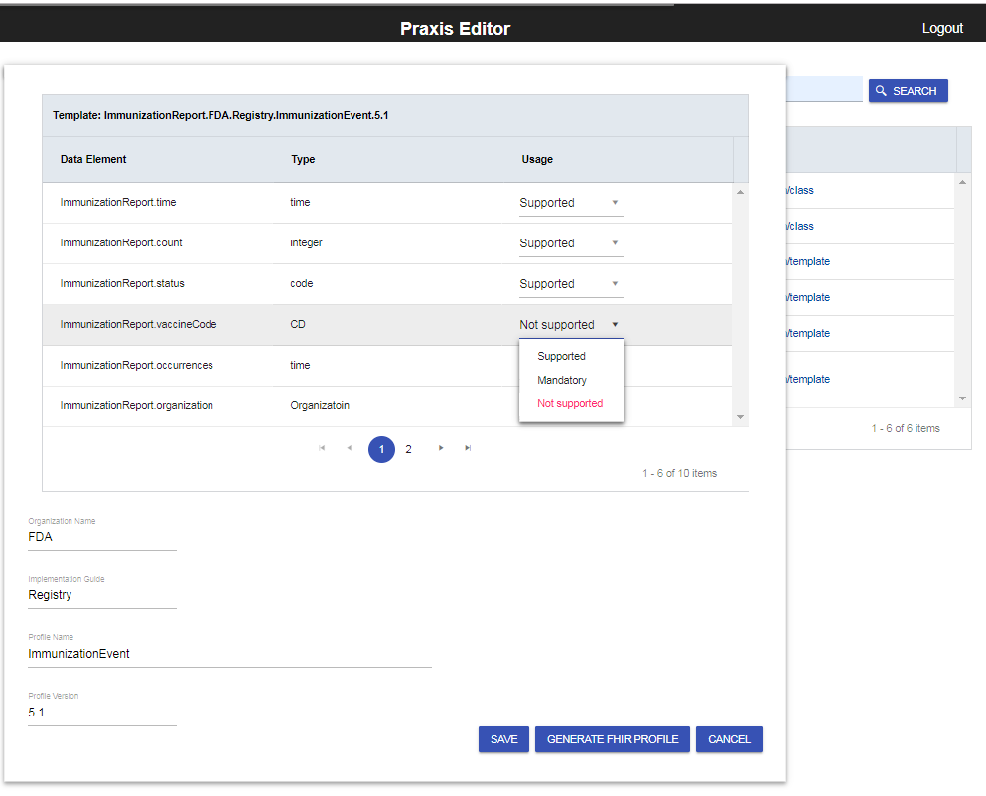
Edit a template
Profile Editor
If the user selects a template from the list of matching results, the user may edit “usage” and metadata:
Organization
Implementation Guide that contains the template
Template title
Template version

Slide 18
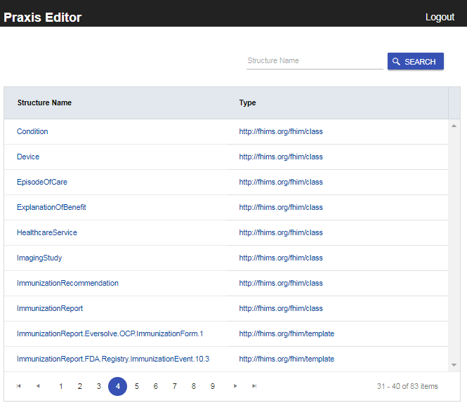
Profile Editor
Search – after saving a template
If the search string is left blank, all the structures will be queried and displayed in alphabetical order, by structure name
Template structure names contain the base class
After saving changes, a search operation will retrieve the latest.
Future enhancement:
Each update creates a new version, future enhancements may access previous versions of a template

Slide 19
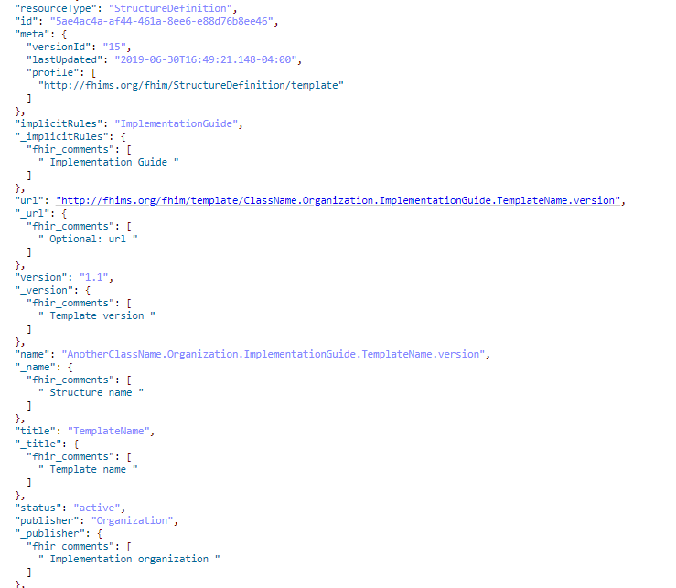
FHIM Template as a StructureDefinition
Implementation Guide
Template Version
Structure Name
Template Name
Organization Name

Slide 20
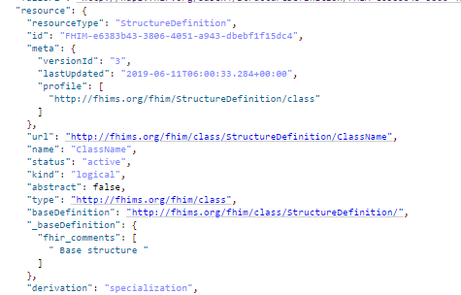
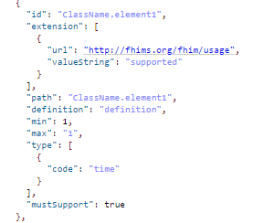
FHIM Class as a StructureDefinition (FHIR R3, R4)
Structure Name
Usage extension
Structure Type

Slide 21
FHIM Profile Builder™
FPB Generator
Federated Health Information Model
Classification: Unrestricted

Slide 22




FPB Profile Generator Overview
1) FPB Editor GET from FHIM Repository
GET: FHIM Element Name
Return: StructureDefinition
FHIR APIs
FHIR Operations
(Structure Definitions)
2) FPB Editor POST to FHIM Repository
POST: FHIM Template StructureDefinition
Return: FHIM Template ID
Profile Generator
(MDHT and
MDMI SEER)
FHIR STU4
Profiles
3) FPB Editor GENERATE to Profile Generator
FHIM
Repository
GENERATE (FHIM Template ID)
RETURN: FHIR Profile ID/Version
4) FPB Editor GET from Profile Generator
GET: FHIR Profile ID & Version
Return: FHIR Profile
Classification: Unrestricted

Slide 23
FPB Profile Generator: Get by Name Service
1) FPB Editor GET
FHIR APIs
FHIR Operations
(Structure Definitions)
GET: FHIM Element Name
Return: StructureDefinition
FPB Editor POST: FHIM Template StructureDefinition
Profile Generator
(MDHT and
MDMI SEER)
FHIR STU4
Profiles
FHIM
Repository
FPB Editor StructureDefinition/GENERATE
STEP 1: To FHIM GET by Name Service | Step 1: From FHIM GET by Name Service
FHIM Element Name | Corresponding FHIM Element(s) based on name as collection of Structured Definitions
FPB Editor GET: FHIR Profile ID & Version
GET: FHIR Profile ID & Version
Return: FHIR Profile
Classification: Unrestricted

Slide 24
FPB Profile Generator : Post Service
1) FPB Editor GET
FHIR APIs
FHIR Operations
(Structure Definitions)
GET: FHIM Element Name
Return: StructureDefinition
2) FPB Editor POST to Profile Generator
Profile Generator
(MDHT and
MDMI SEER)
POST: FHIM Template StructureDefinition
Return: FHIM Template ID
FHIR STU4
Profiles
FHIM
Repository
FPB Editor StructureDefinition/GENERATE
GENERATE
RETURN: FHIR Profile ID/Version
STEP 2: To Profile Generator Post Service | Step 2: From Profile Generator Post Service
FHIM Template Structure Definition | FHIM Template ID
FPB Editor GET: FHIR Profile ID & Version
GET: FHIR Profile ID & Version
Return: FHIR Profile
Classification: Unrestricted

Slide 25
FPB Profile Generator : Generate Service
FPB Editor GET
FHIR APIs
FHIR Operations
(Structure Definitions)
GET: FHIM Element Name
Return: StructureDefinition
2). FPB Editor POST: FHIM Template StructureDefinition
Profile Generator
(MDHT and
MDMI SEER)
POST: FHIM Template StructureDefinition
Return: FHIM Template ID
FHIR STU4
Profiles
FHIM
Repository
3) FPB Editor GENERATE
GENERATE
RETURN: FHIR Profile ID/Version
STEP 3: To Generate Service | STEP 3: From Generate Service
FHIM Template ID | FHIR Profile ID
FPB Editor GET: FHIR Profile ID & Version
GET: FHIR Profile ID & Version
Return: FHIR Profile
Classification: Unrestricted

Slide 26
FPB Profile Generator : Generate Sub-processes
1) Identify Components using SEER
FPB Profile Editor
2) Calculate Deltas
FHIR APIs
FHIR Operations
(Structure Definitions)
Profile Generator
(MDHT and
MDMI SEER)
FHIR STU4
Profiles
4) Generate FHIR Artefacts
3) Save Results
FHIM
Repository
Classification: Unrestricted

Slide 27
FPB Profile Generator : GET by ID Service
FPB Editor GET
FHIR APIs
FHIR Operations
(Structure Definitions)
GET: FHIM Element Name
Return: StructureDefinition
2). FPB Editor POST: FHIM Template StructureDefinition
Profile Generator
(MDHT and
MDMI SEER)
POST: FHIM Template StructureDefinition
Return: FHIM Template ID
FHIR STU4
Profiles
FHIM
Repository
3) FPB Editor StructureDefinition/GENERATE
GENERATE
RETURN: FHIR Profile ID/Version
STEP 4: To Generator GET by ID Service | STEP 4: From Generator Get by ID Service
FHIR Profile ID | FHIR Profile as Structure Definition
FPB Editor GET
GET: FHIR Profile ID & Version
Return: FHIR Profile
Classification: Unrestricted

Slide 28
Comparison of US Core and FPB Generated FHIR Profiles
Task: Using the FHIM Profile Builder Model Driven Architecture approach, generate the equivalent of US Core FHIR profiles (that were originally developed manually)
Objective: Validate that the FHIM and FPB modeling services can produce high quality, accurate and consistent FHIR profiles that are equivalent to US Core FHIR profiles.
Use Case: The Immunization for US Core FHIR profile. This profile sets the minimum expectations for the Immunization resource to record, fetch and search immunization history associated with a patient. It identifies which core elements, extensions, vocabularies and value sets SHALL be present in the resource when using this profile.
  Usage scenarios: for the US Core FHIR Immunization profile are:
    Query for immunizations belonging to a Patient
    Record immunizations belonging to a Patient
Conclusion: The FPB generated FHIR profiles duplicate the intent and semantics of the original US Core FHIR profiles. Every element detailed in US Core FHIR Profiles were replicated by the FHIM generated version.
Classification: Unrestricted

Slide 29
Comparison of US Core and FPB Profiles
Using US Core FHIR Exchange Requirements for Immunizations
FHIR US Core Immunization Element | FHIM Vaccination Event Element | Congruent
status | status | Yes
statusReason | statusReason | Yes
vaccineCode | vaccineCode | Yes
patient | patient | Yes
occurrenceDateTime | dateTime | Yes
primarySource | source | Yes
Classification: Unrestricted

Slide 30
Conclusions
FHIM Profile Builder (FPB) will reduce implementation variability a thereby increasing interoperability.
FBP can generate US Core profiles and extensions
FPB can generate CDA and other implementations
FPB is efficient and effective
FPB is a faster, better and cheaper approach to creating FHIR, CDA and other implementation paradigm profiles and extensions.
You are invited to participate in FPB evolution and use!
Classification: Unrestricted

Slide 31



FHIM Profile Builder Point of Contact
Jason Lee PhD, Director, OpenGroup
Healthcare Vertical
j.lee@opengroup.org
(774) 444-0880
@jasonsleephd
Thank You and Please Participate
Classification: Unrestricted

Slide 32
Glossary
Binding is the association of a medical term with a terminology or code system or value set, such as SNOMED, LOINC, RxNorm terminology and codes.
Classes: (in information modeling) sets, collections, concepts, types of objects, or kinds of things.
Domain: a set of classes, attributes and relationships that describe a subject area.
Domain Model: a conceptual model of a system which describes the various entities involved in that system and their relationships. In UML modeling, a class diagram is used to represent the domain model.
Element: an item in a UML information model (e.g., class, data attribute, relationship, etc.).
Information Model: (in software engineering) a representation of concepts, relationships, constraints, rules and operations to specify data semantics for a chosen domain of discourse. It can provide sharable, stable, and organized structure of information requirements for the domain context.
Logical Information Model: (in systems engineering) a representation of information, organized in terms of classes and relationships and is independent of any particular technology (database) platform. The logical information model can become the basis of a physical data model and inform the design of a database. Logical information and physical data models are very different in their objectives, goals and content.
Physical Data Model: a representation of a data design which takes into account the facilities and constraints of a given database management system.
Reusable: implies that an IT component has been modularized, standardized and tested so that it can be efficiently and effectively used, in similar contexts, by others.
Semantic Data Model: (in software engineering) a data modeling technique to define the meaning of data within the context of its interrelationships with other data. A semantic data model is an abstraction which defines how the stored symbols relate to the real world. A semantic data model is sometimes called a conceptual data model.
Terminology: is the study of terms and their use. Terminology denotes a formal discipline which systematically studies the labeling or designating of concepts particular to one or more subject areas of human activity, through research and analysis of terms in context, for the purpose of documenting and promoting
correct usage.
Classification: Unrestricted

